Slide 1
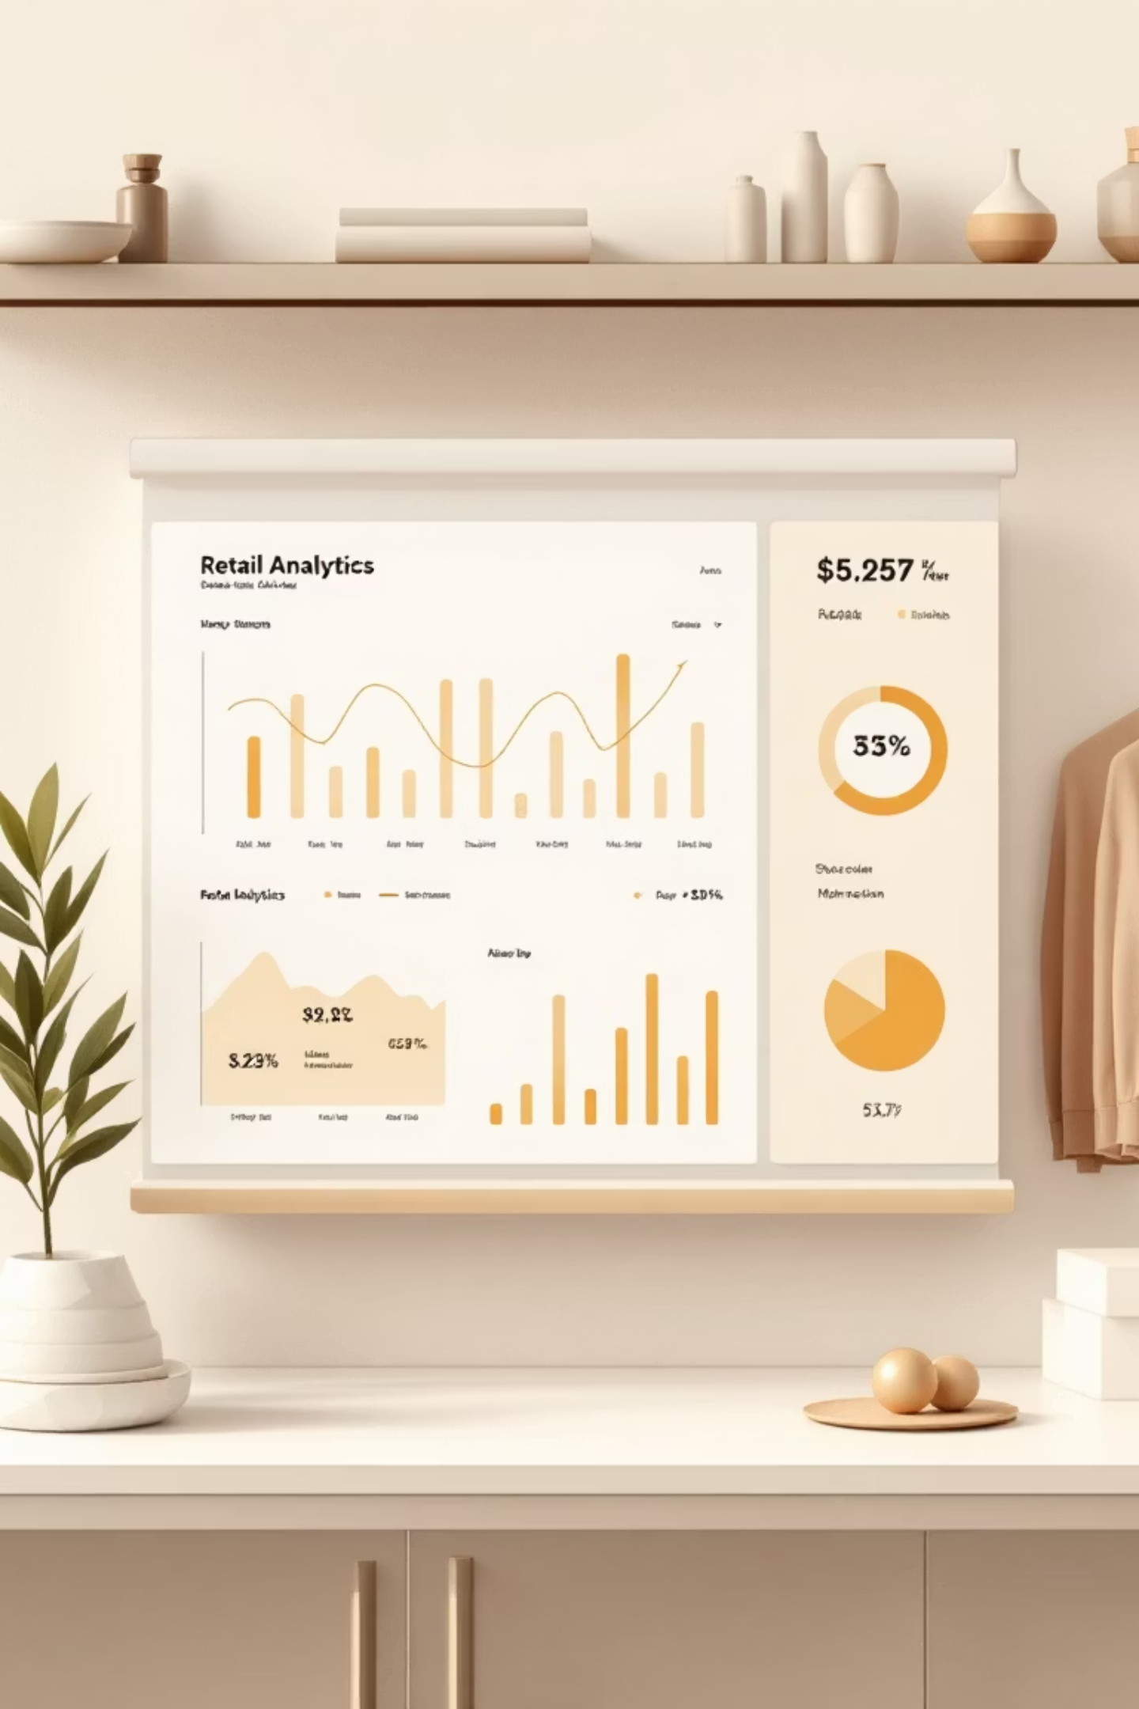
Customer Shopping Behavior Analysis
Uncovering insights from 3,900 purchases to guide strategic business decisions

Slide 2


DATASET OVERVIEW
The Foundation
3,900
18
50
Total Purchases
Data Points
Locations
Transactions analyzed across all categories
Features per customer transaction
Geographic coverage nationwide
25
Products
Unique items purchased

Slide 3





PYTHON ANALYSIS
Data Preparation Pipeline
Data Loading
Cleaning
Imported dataset using pandas
Imputed 37 missing review ratings by category median
Engineering
Integration
Created age groups and purchase frequency metrics
Loaded to PostgreSQL for SQL analysis

Slide 4
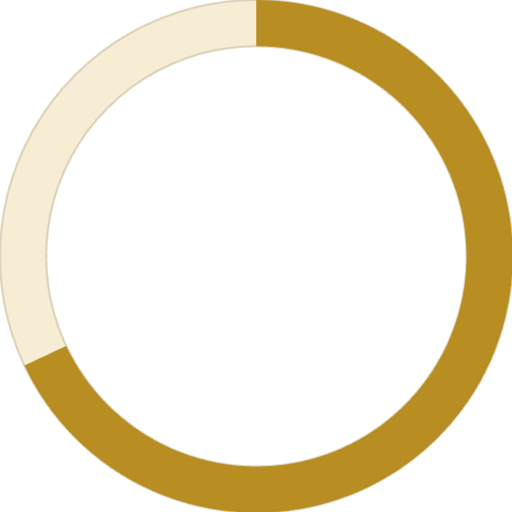
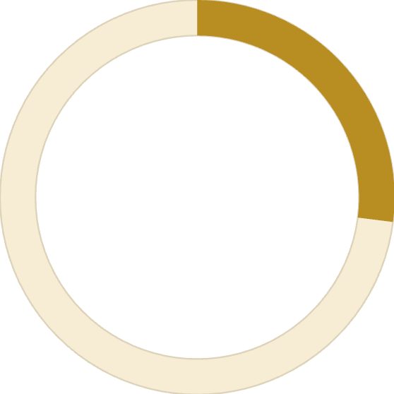
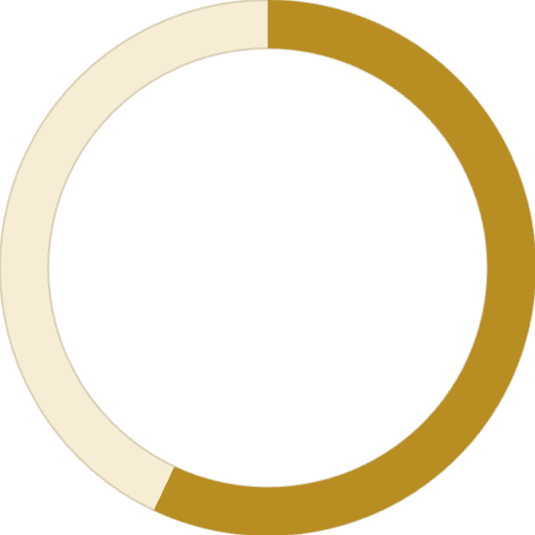
KEY METRICS
Customer Demographics at a Glance
Age Distribution
Median: 44 years
Range: 18-70 years
68%
27%
Purchase Behavior
Avg Amount: $59.76
Avg Rating: 3.75/5.0
Male Customers
Subscribers
Driving majority of revenue
Active subscription base
57%
Discount Users
Applied promotional offers

Slide 5
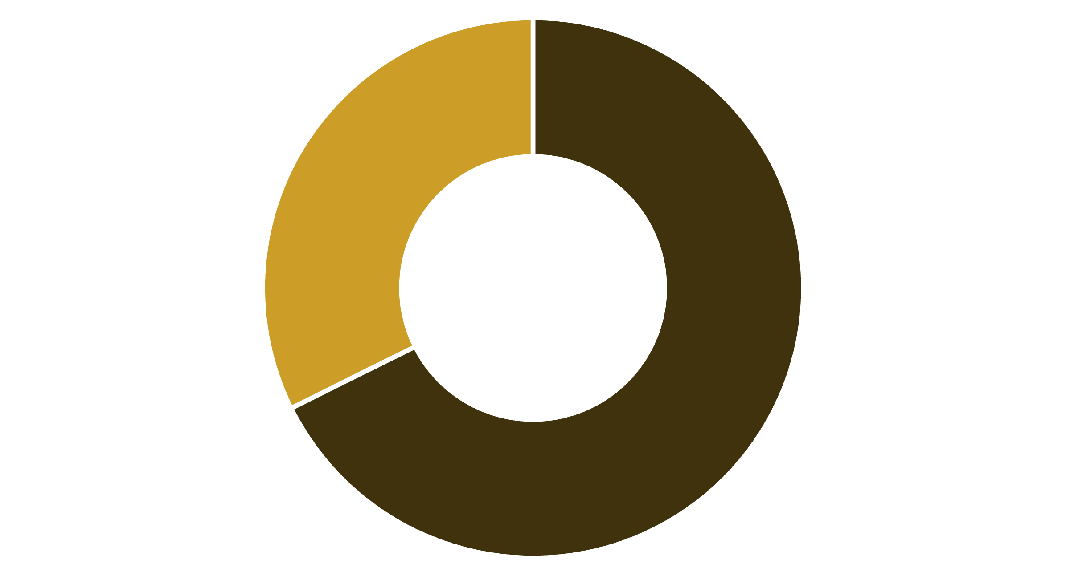
REVENUE ANALYSIS
Revenue by Gender
Male
Female
Male Revenue
Female Revenue
$157,890 total spend
$75,191 total spend
68% of total revenue
32% of total revenue

Slide 6
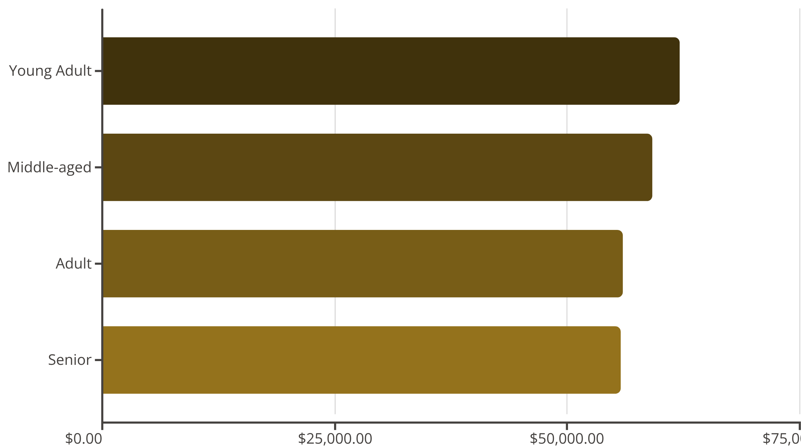
Revenue by Age Group
Young Adults Lead
Balanced Distribution
Highest revenue contribution at $62,143
All age groups show strong engagement

Slide 7
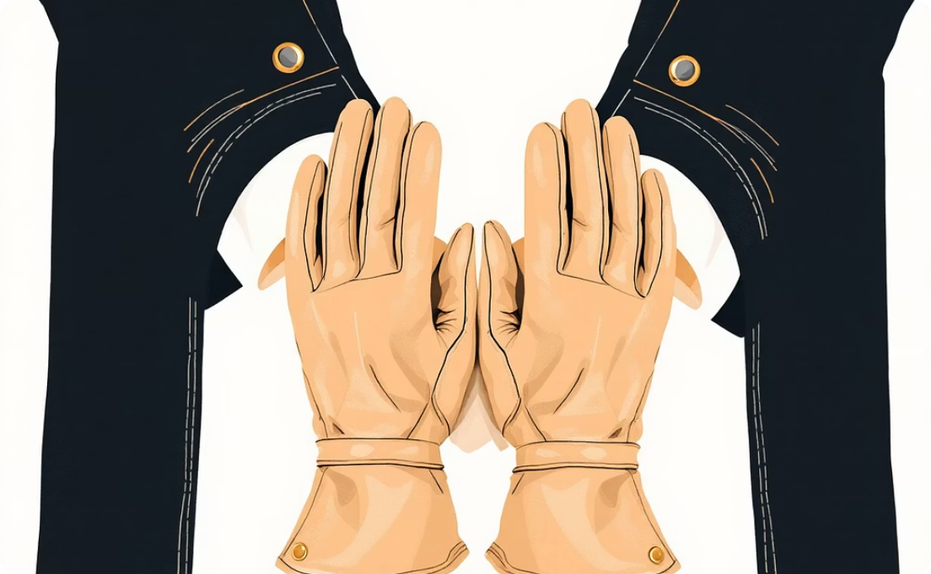

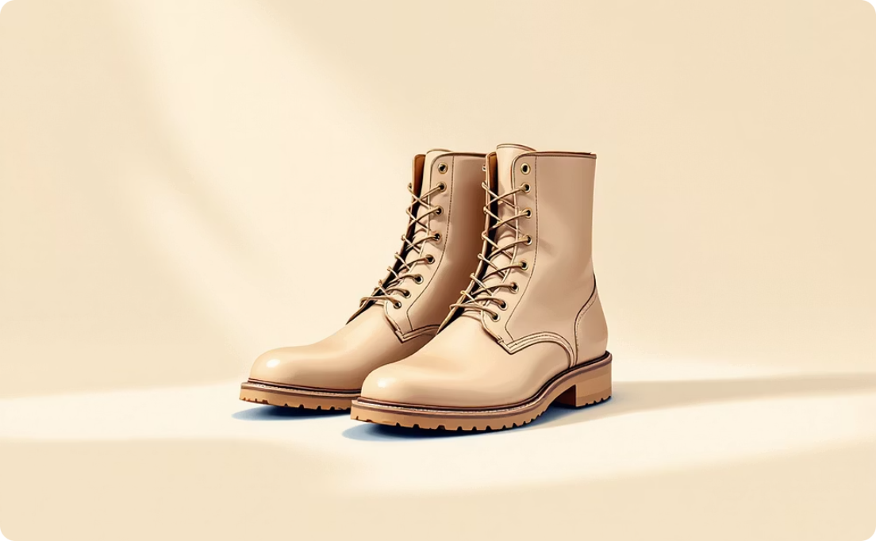
PRODUCT INSIGHTS
Top Performers
Gloves
Sandals
Boots
Rating: 3.86/5.0
Rating: 3.84/5.0
Rating: 3.82/5.0
Highest-rated product
Second highest rating
Consistent performer
Clothing Category
Accessories
Leads with $100K revenue and 1,800 sales
Strong second at $80K revenue

Slide 8



CUSTOMER SEGMENTS
Loyalty Distribution
Returning
701 customers
Loyal
18% of customer base
3,116 customers
Growing loyalty potential
80% of customer base
Repeat buyers with strong engagement
New
83 customers
2% of customer base
Fresh acquisition opportunities

Slide 9
DISCOUNT ANALYSIS
Discount Impact
50%
High-Value Discount Users
Hats
839 customers used discounts but spent above average ($59.76)
Highest discount rate
Shipping Preferences
49.7%
Express: $60.48 avg
Sneakers
Standard: $58.46 avg
49.1%
Coats

Slide 10
STRATEGIC RECOMMENDATIONS
Action Plan
01
02
03
Boost Subscriptions
Loyalty Programs
Review Discount Policy
Promote exclusive benefits to convert 73% non-subscribers
Reward repeat buyers to strengthen 80% loyal segment
Balance sales growth with margin control on high-discount items
04
05
Product Positioning
Targeted Marketing
Highlight top-rated items (Gloves, Sandals, Boots) in campaigns
Focus on Young Adults and express-shipping users for maximum ROI

